Slide 1
MASTERPIECES OF WESTERN ART Art Humanities W1121 Section 15
Bernini
(Part 1)

Slide 2
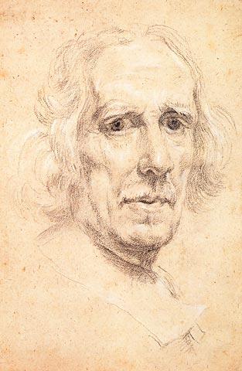
Bernini
Self-Portrait
c. 1665

Slide 3
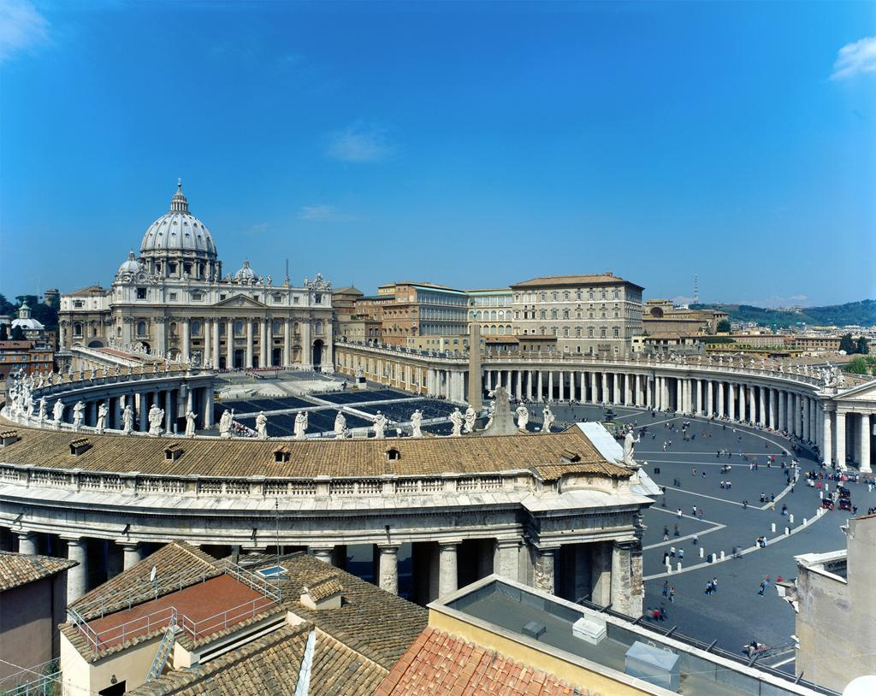
Bernini, St Peter’s Square, 1656-57

Slide 4
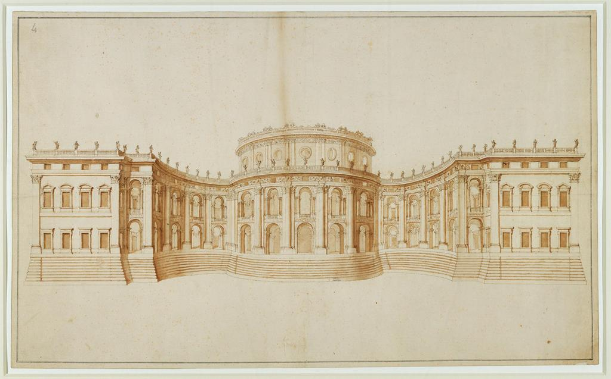
Bernini, First Project for the Louvre, 1664

Slide 5
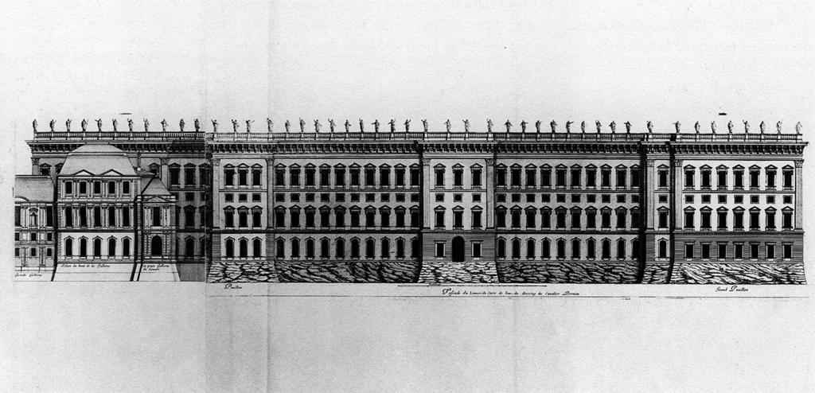
Bernini, Third Project for the Louvre, 1665
Engraved by Jean Marot

Slide 6
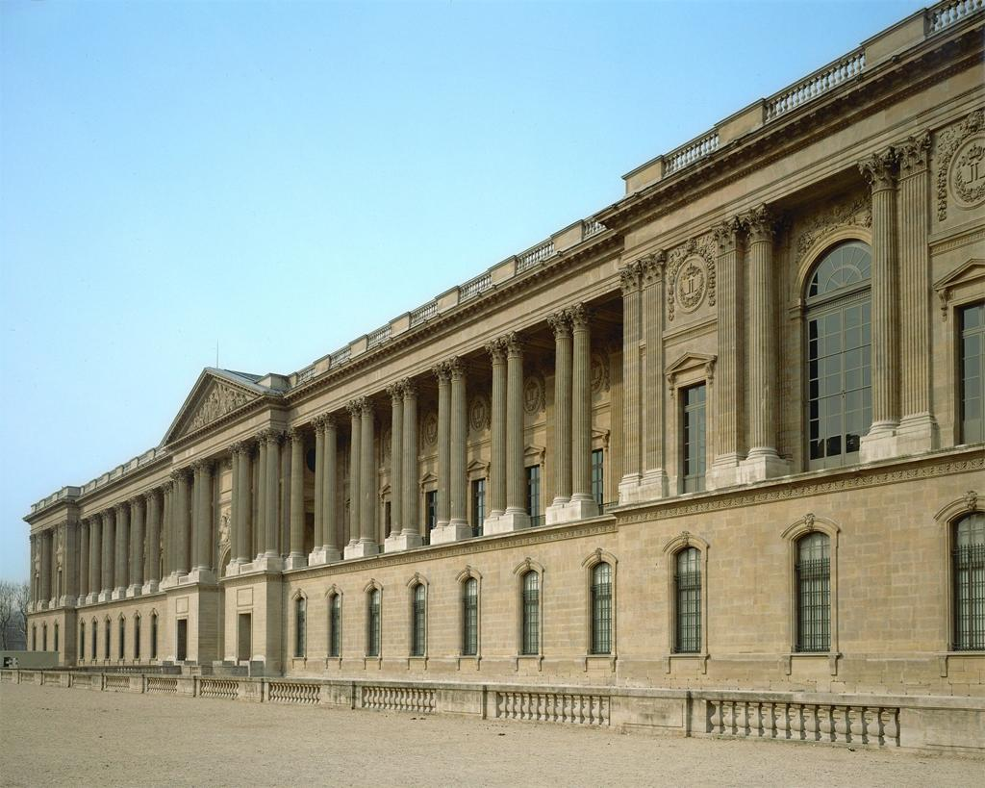
Claude Perrault, Colonnade of the Louvre, 1667-74

Slide 7
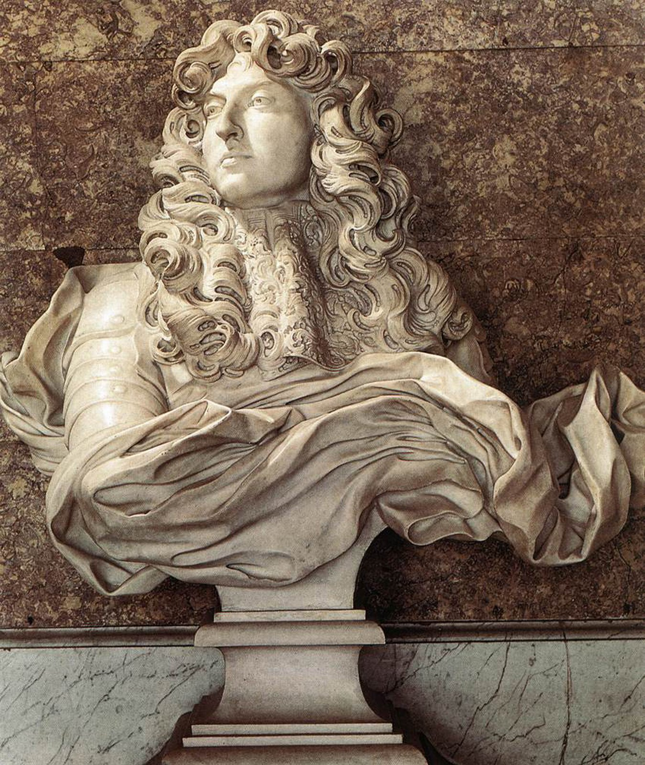
Bernini
Portrait Bust of Louis XIV
1665

Slide 8
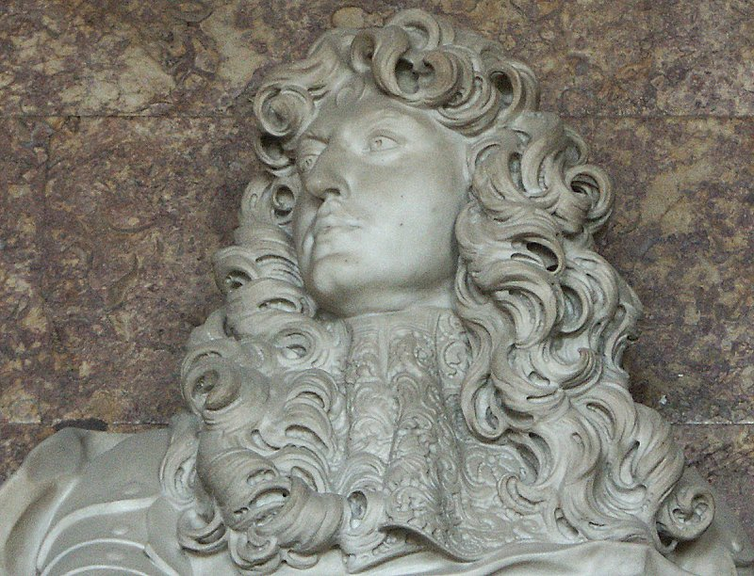

Slide 9
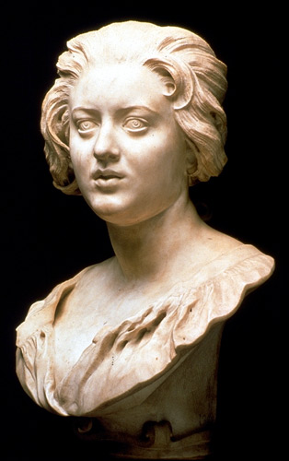
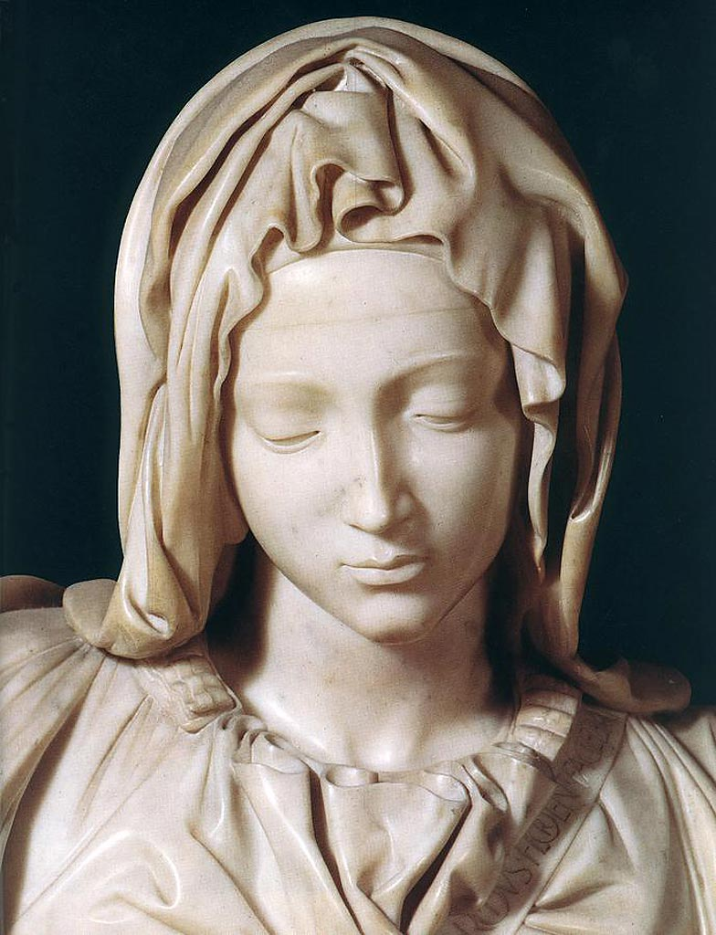
Michelangelo
Pieta (Detail of Mary)
1497-1500
Bernini
Portrait Bust of Costanza Bonarelli
1635

Slide 10
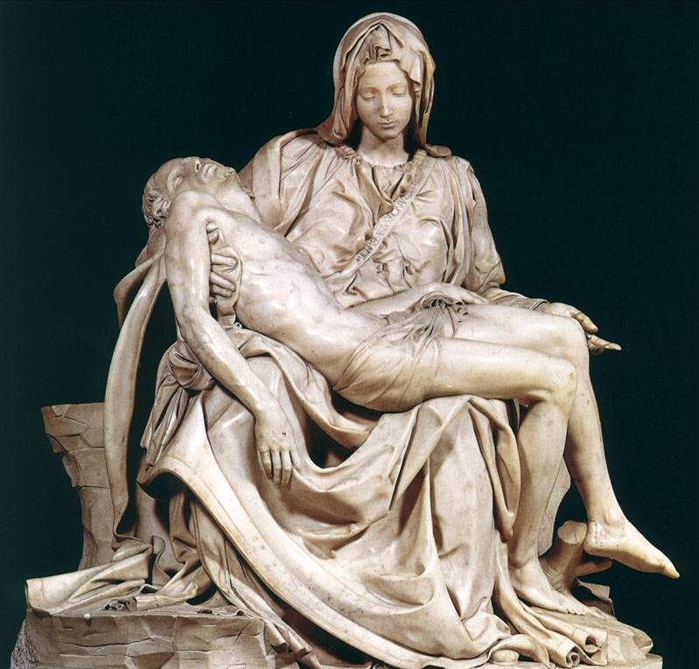

Slide 11
Bernini
Portrait Bust of Costanza Bonarelli
1635

Slide 12
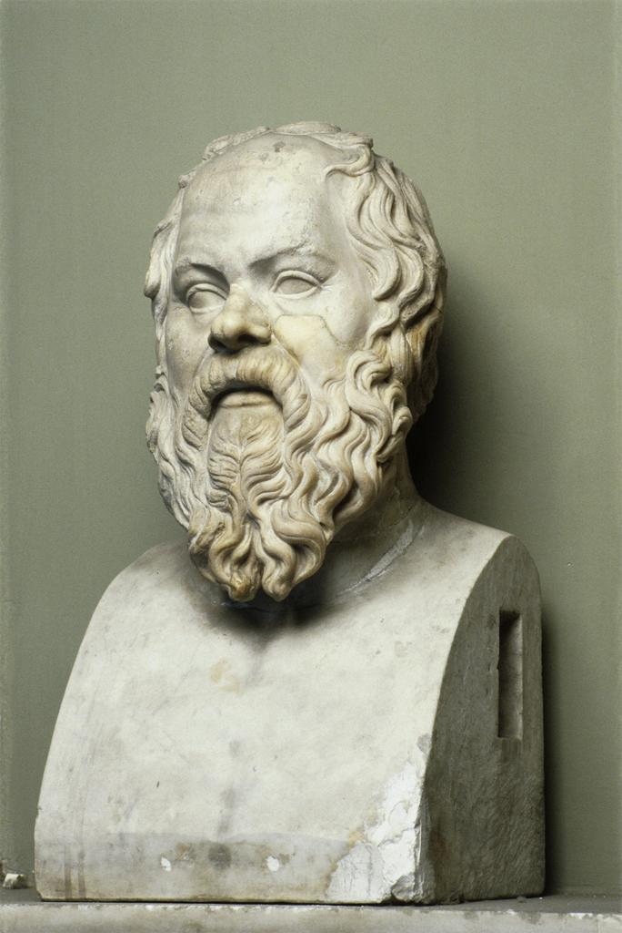
Lysippos
Head of Socrates
4th c. B.C.

Slide 13
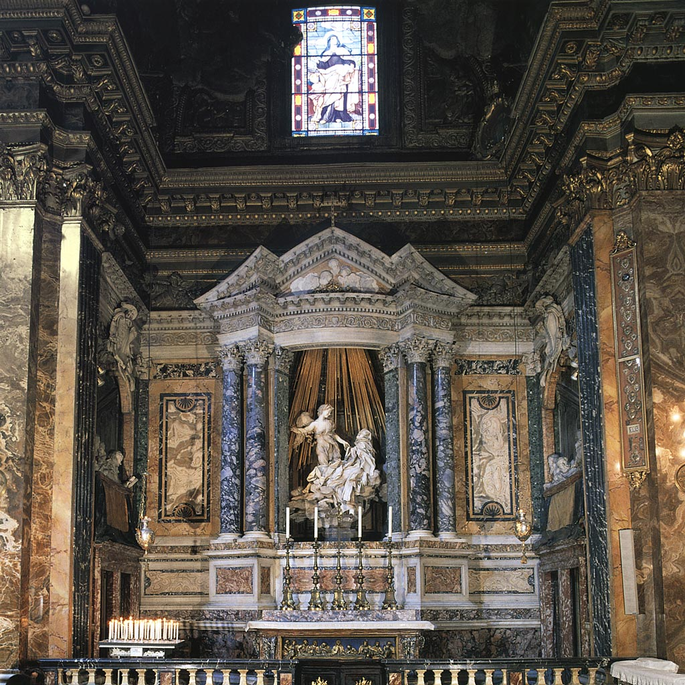
Bernini
Ecstasy of Saint Theresa
Cornaro Chapel
Santa Maria della Vittoria
Rome
1645-52

Slide 14
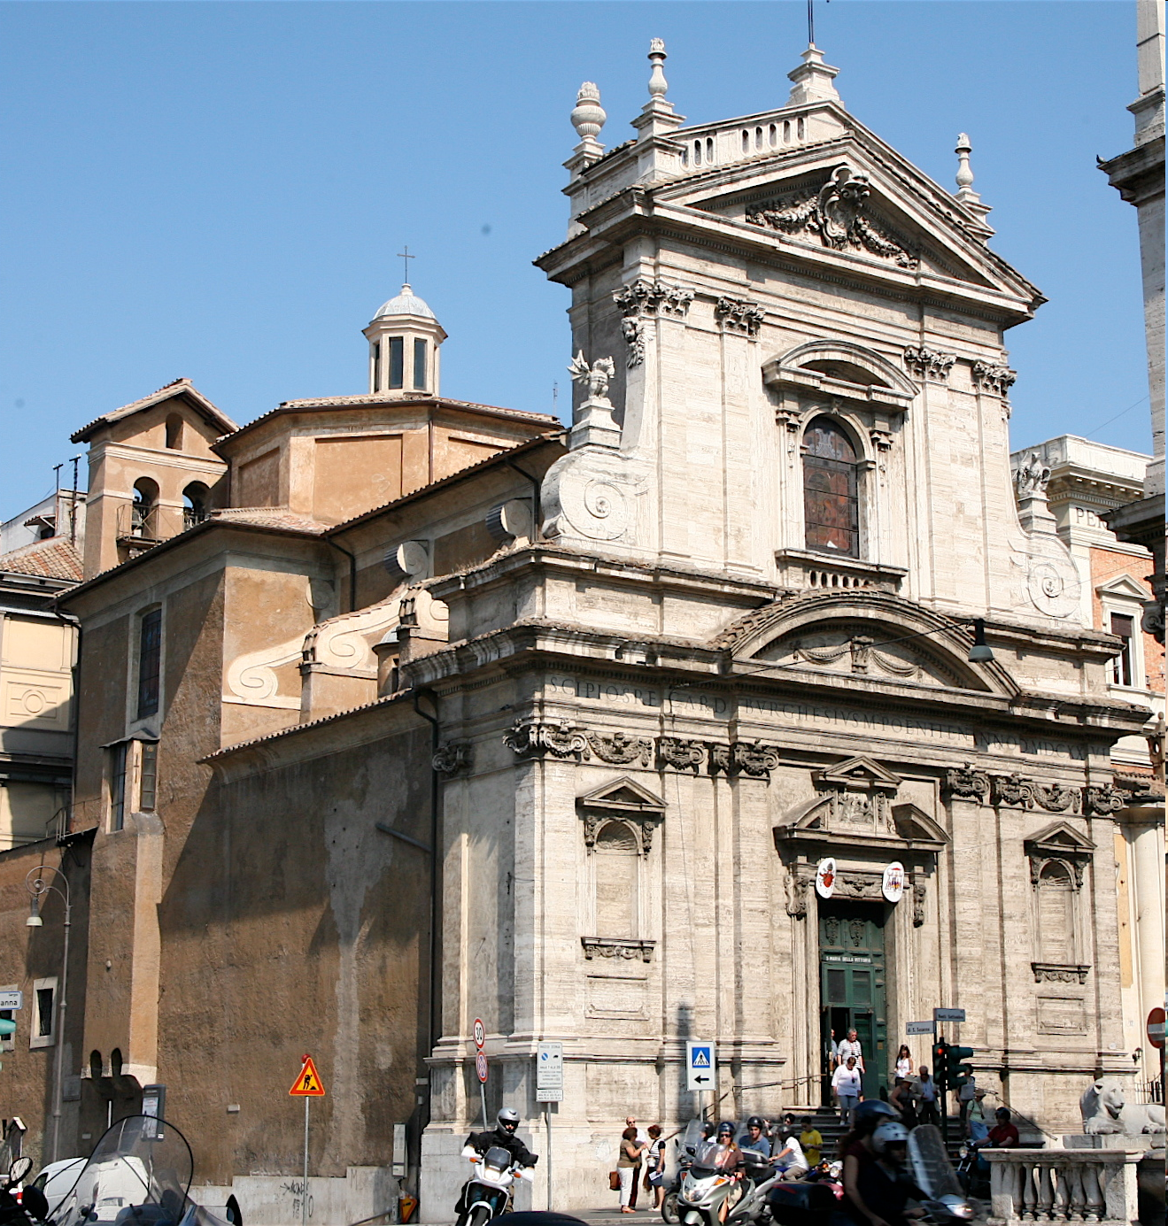
Santa Maria della Vittoria
Rome

Slide 15
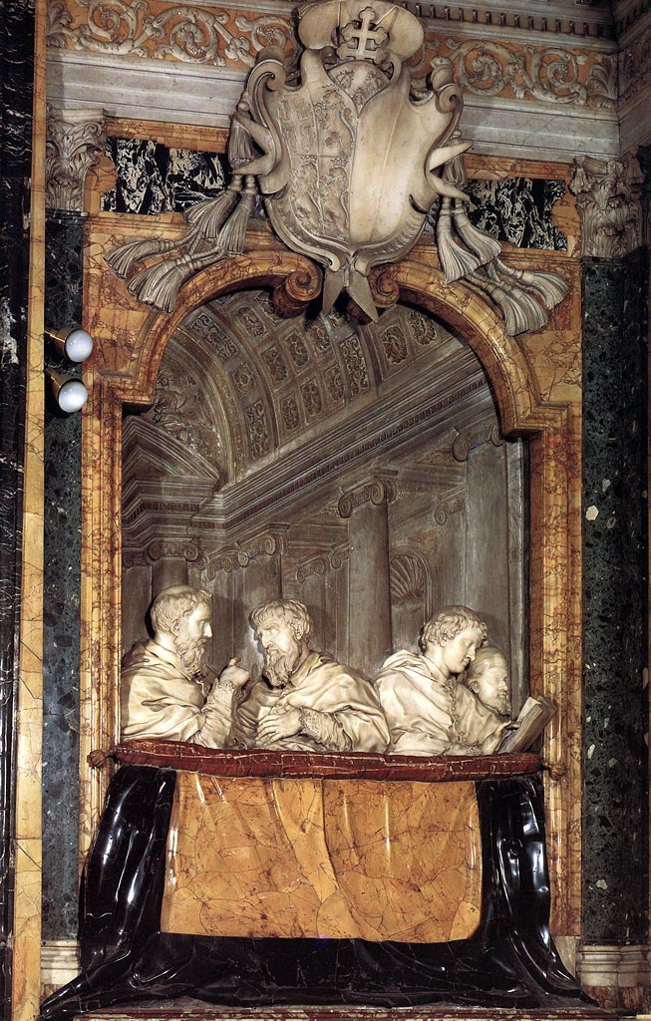
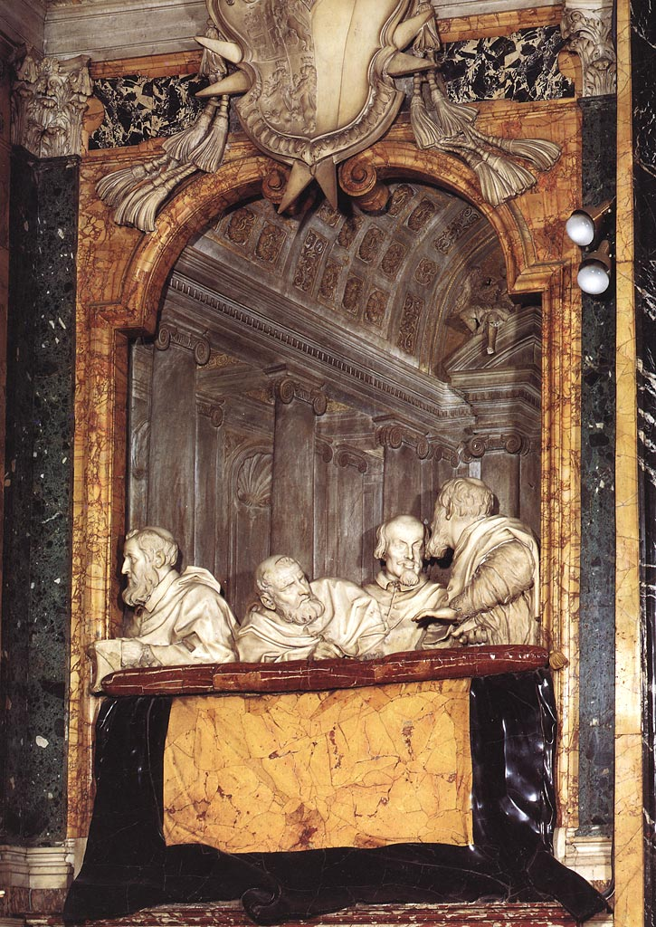

Slide 16
